Slide 1
A CASE REPORT OF OCCULAR CYSTICERCOSIS
Presenters:: Dr. Vaishali Prajapati (Associate Professor)
Dr. Krishna Shah (2nd year resident)
Dr. Deepika Singhal (Professor and Head)
Institute:
GMERS Medical College And Civil Hospital, Sola, Ahmedabad

Slide 2
INTRODUCTION
Cysticercosis is a parasitic infection caused by the larval form of the cestode, Taenia solium (T. solium), also known as a pork tapeworm.
Orbital/ocular cysticercosis (OOC) is a preventable cause of blindness.
The posterior segment of the eye is one of the most common sites of infection.
35% of the cysts were found in the subretinal space,
22% in the vitreous, 22% in the subconjunctival space,
5% in the anterior segment, and
only 1% in the orbit.
When the extraocular muscles are involved,
the superior rectus is the most common.

Slide 3
CASE
A 31 year old male patient presented to a tertiary care teaching hospital with
complain of pain and swelling in left eye since 3 months.
There was no past history of the patient or family member travelling to or residing in an endemic country for cy
sticercosis.
No other ocular complaints.
EXAMINATIONS
 | Right Eye | Left Eye
Vision (BCVA) | 6/6 | 6/9 +1D sph
Colour Vision | Normal | Normal
Cornea | Clear | Clear
Conjunctiva | Normal | Mild conjunctival congetion

Slide 4
EXAMINATION continue……..
 | Right Eye | Left Eye
Anterior Chamber | Normal depth | Normal depth
Iris | Normal | Normal
Pupil | Normal size, shape & reacting to light | Grade-1 RAPD
Lens | Clear | Clear
Extra ocular movement | normal | Superior & inferior movement restricted
Applanation tonometry | 12 Mm Hg | 38 mmhg
Fundus | Normal | Initially normal, After 2 week – CSR developed (due to steroid)

Slide 5
Dignosis & Managment
Imaging studies such as B-scan ultrasonography, computed tomography (CT), magnetic resonance imaging (MRI) are most helpful in providing definitive diagnosis.
Ocular B-scan –Normal
CT scan- revealed a hypoechoic mass inferiorly with adjacent soft tissue inflammation probably involving inferior rectus muscle
Rest all routine investigation (CBC,ESR, HIV, Hbsag)- normal
Treatment
As prognosis of OCC is best if treatment is started early, Oral albendazole was started.
Injectable steroids were given to reduce inflammation.
As there was high IOP, YAG-PI (peripheral iridotomy) was done along with anti glaucoma drops to reduce tension in left eye.

Slide 6
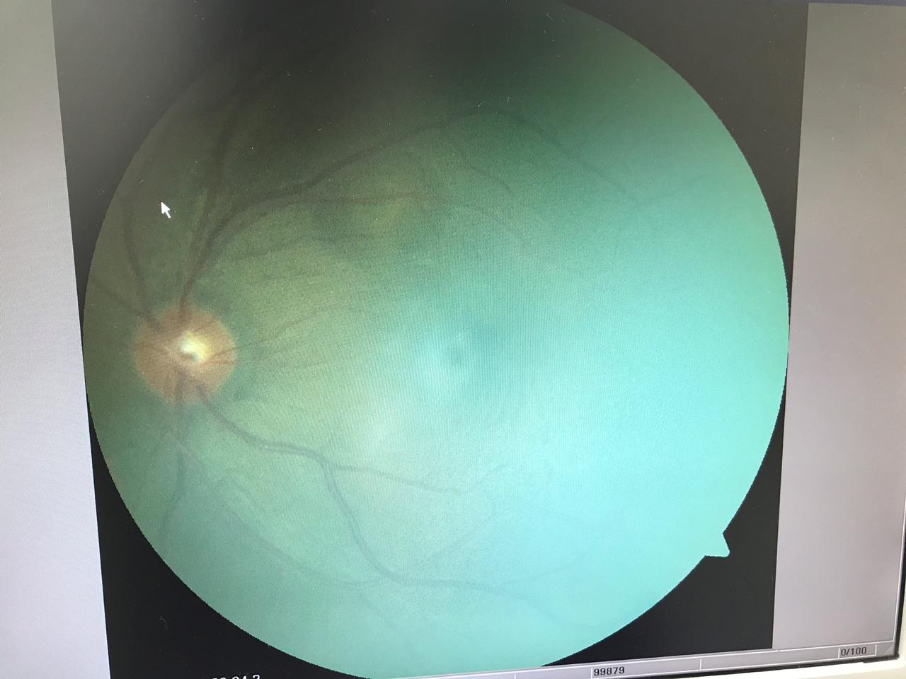
Fundus Photo of Right eye
Showing CSR superionasally to macula

Slide 7


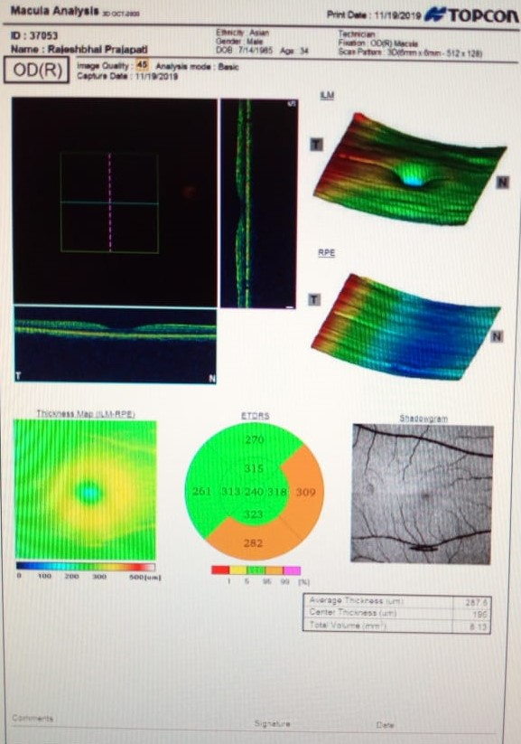
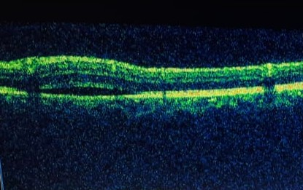



OCT of Right eye

Slide 8
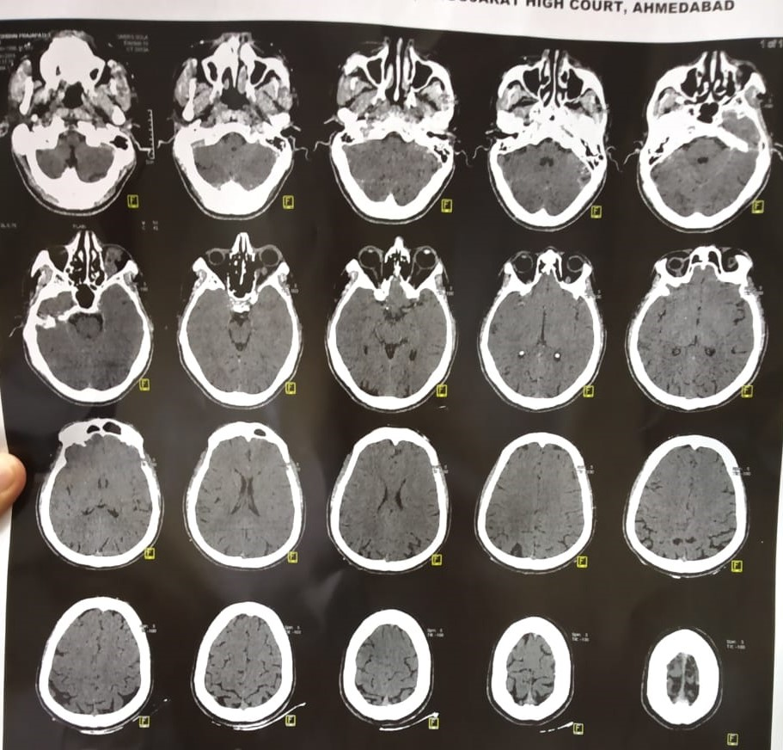
CT Scan Showing hyperechoic mass probably thickened inferior rectus muscle of Right eye.

Slide 9
Discussion
Appropriate sanitation and personal hygiene are important in control of fecal contamination of water and food.
Raw and improperly cooked food should be avoided, especially in endemic areas.
Once the diagnosis of orbital cysticercus is confirmed, it is of utmost important to rule out intraocular and central nervous system involvement.
Dying cysticercus releases its toxin and incites severe inflammatory reaction leading to vitritis and may lead to blindness. Hence it is mandatory to check for intraocular involvement of cysticercus cyst.
As the cyst is usually adherent to the adjacent muscle, excision may be difficult. Care must be taken to keep the extraocular muscle intact during dissection.
If the cyst wall is opened, the content should be aspirated and the area irrigated with hypertonic saline.
Medical management in orbital cysticercosis is extremely effective and achieves clinical resolution in most patients.
Cure rates range from 60 to 85% in the usual dosing with most series showing albendazole yielding slightly higher cure rates

Slide 10
References
DeGiorgio CM, Medina MT, Durón R, Zee C, Escueta SP. Neurocysticercosis. Epilepsy Curr. 2004;4(3):107–111. doi:10.1111/j.1535-7597.2004.43008.x
3 Dhiman R, Devi S, Duraipandi K, et al. Cysticercosis of the eye. Int J Ophthalmol. 2017;10(8):1319–1324. Published 2017 Aug 18. doi:10.18240/ijo.2017.08.21
Sekhar GC, Lemke BN. Orbital cysticercosis. Ophthalmology. 1997;104:1599–1602.
JMalik SR, Gupta AK, Choudhry S. Ocular cysticercosis. Am J Ophthalmol. 1968;66(6):1168–1171.
Reddy PS, Satyendran OM. Ocular cysticercosis. Am J Ophthalmol. 1964;57:664–666.

Slide 11


